Slide 1
Week 13: Introduction to Deep Learning-Based Object Detection
Thursday, April 6th, 2023

Slide 2
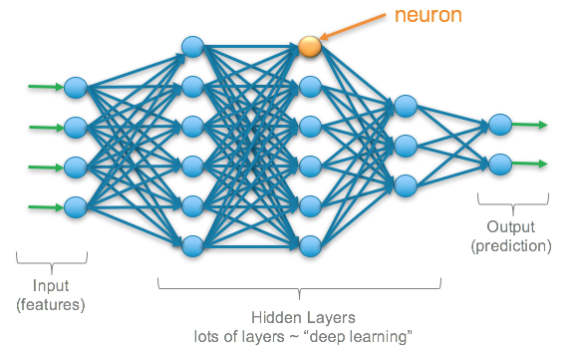





What is Deep Learning?
https://tinyurl.com/umrdb7x
Artificial Intelligence
https://tinyurl.com/t9d3zmg
Providing machine with the ability to learn using neurons
Machine Learning
Classifying the weed species
Detect soil conditions
Deep Learning
Detect foliar diseases
Notes:
Deep learning is a subset of machine learning
Deep learning is subset of machine learning where computer learn in a manner similar to how the human brain works using neurons

Slide 3
Types of Deep Learning Techniques?
Image Classification
Object Detection

Slide 4
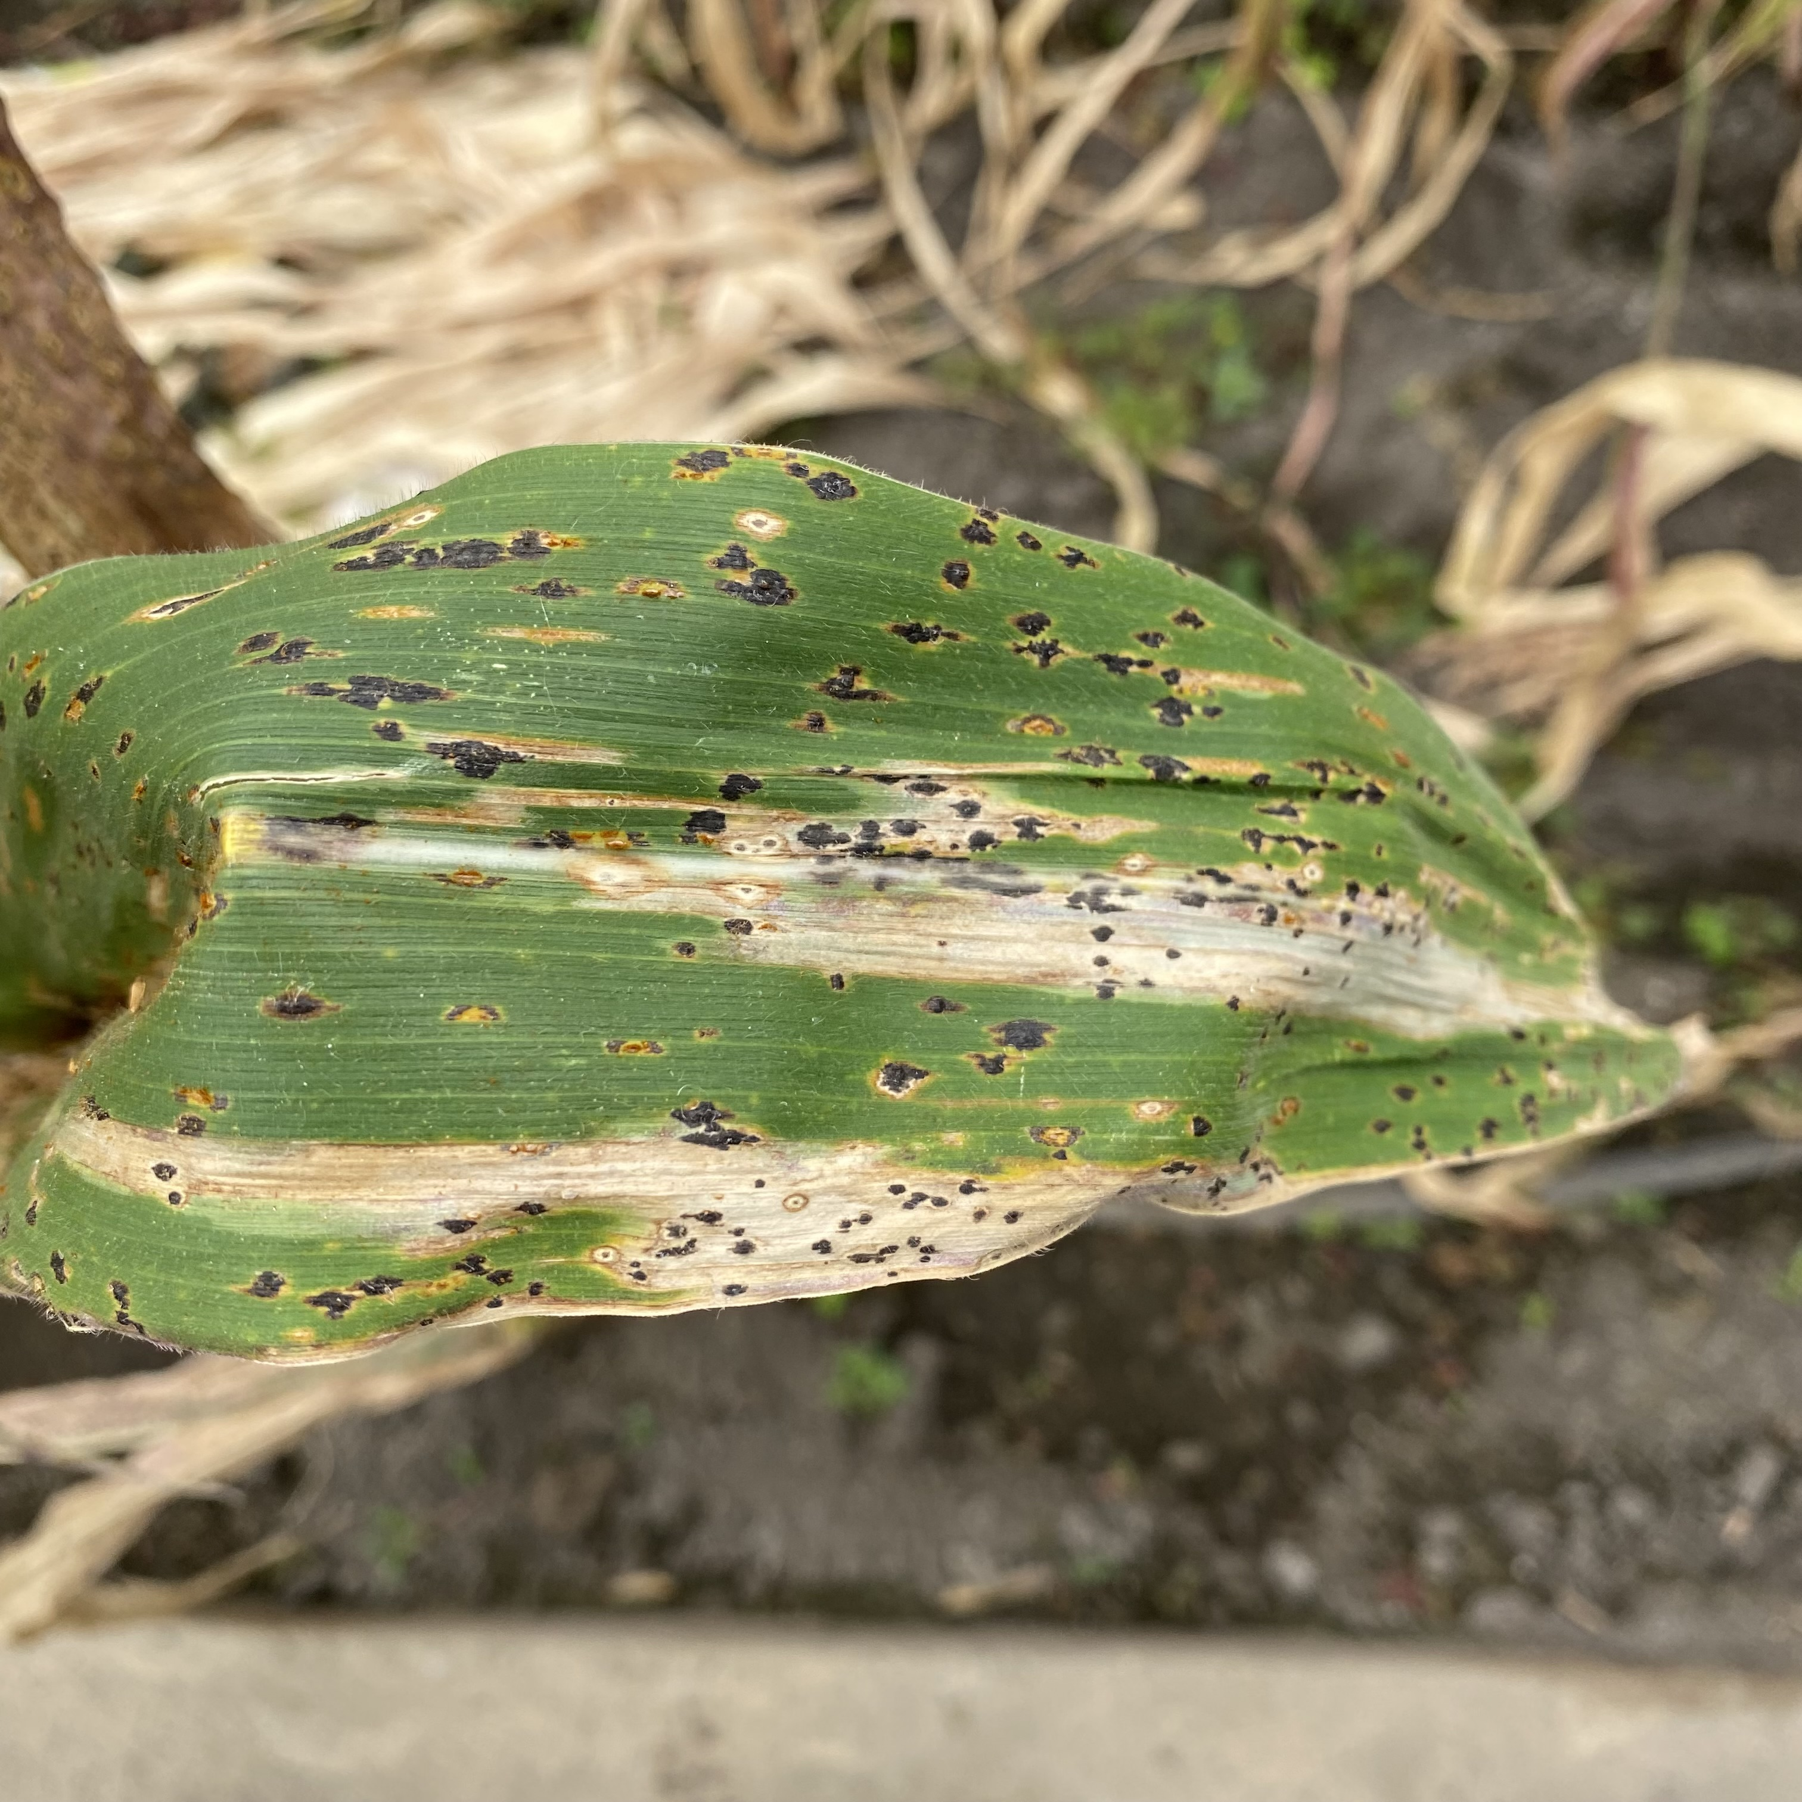
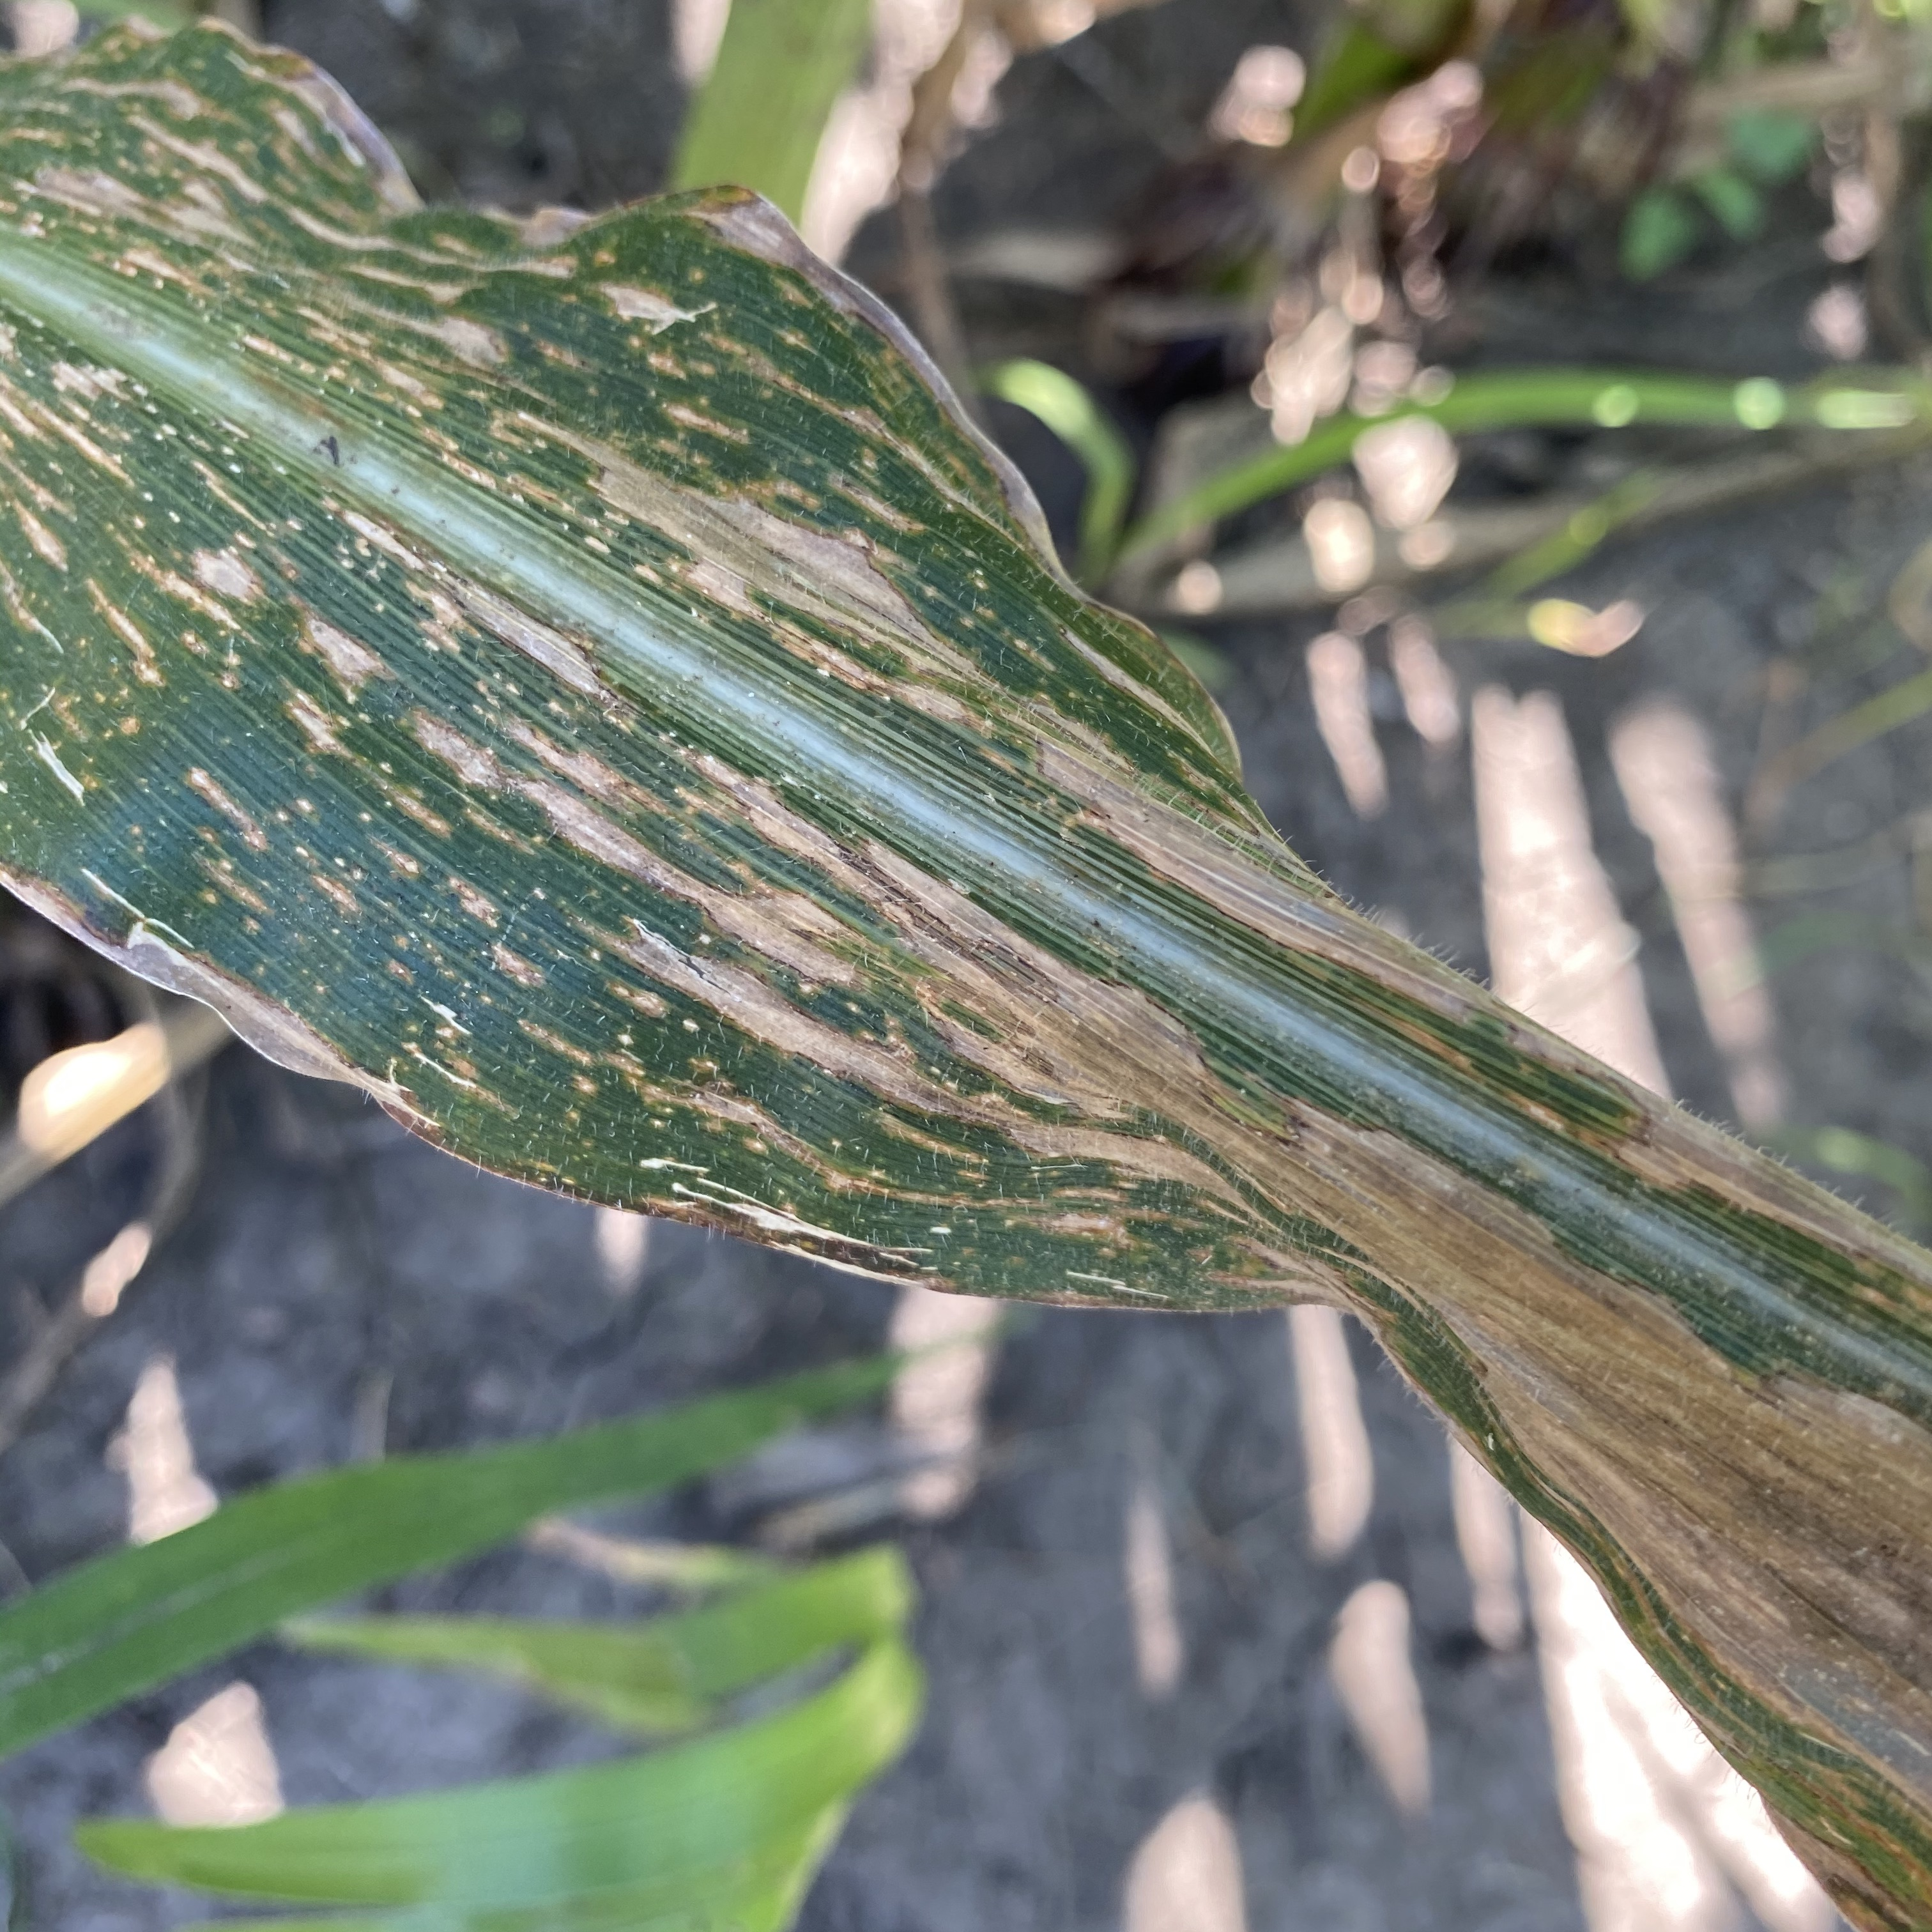
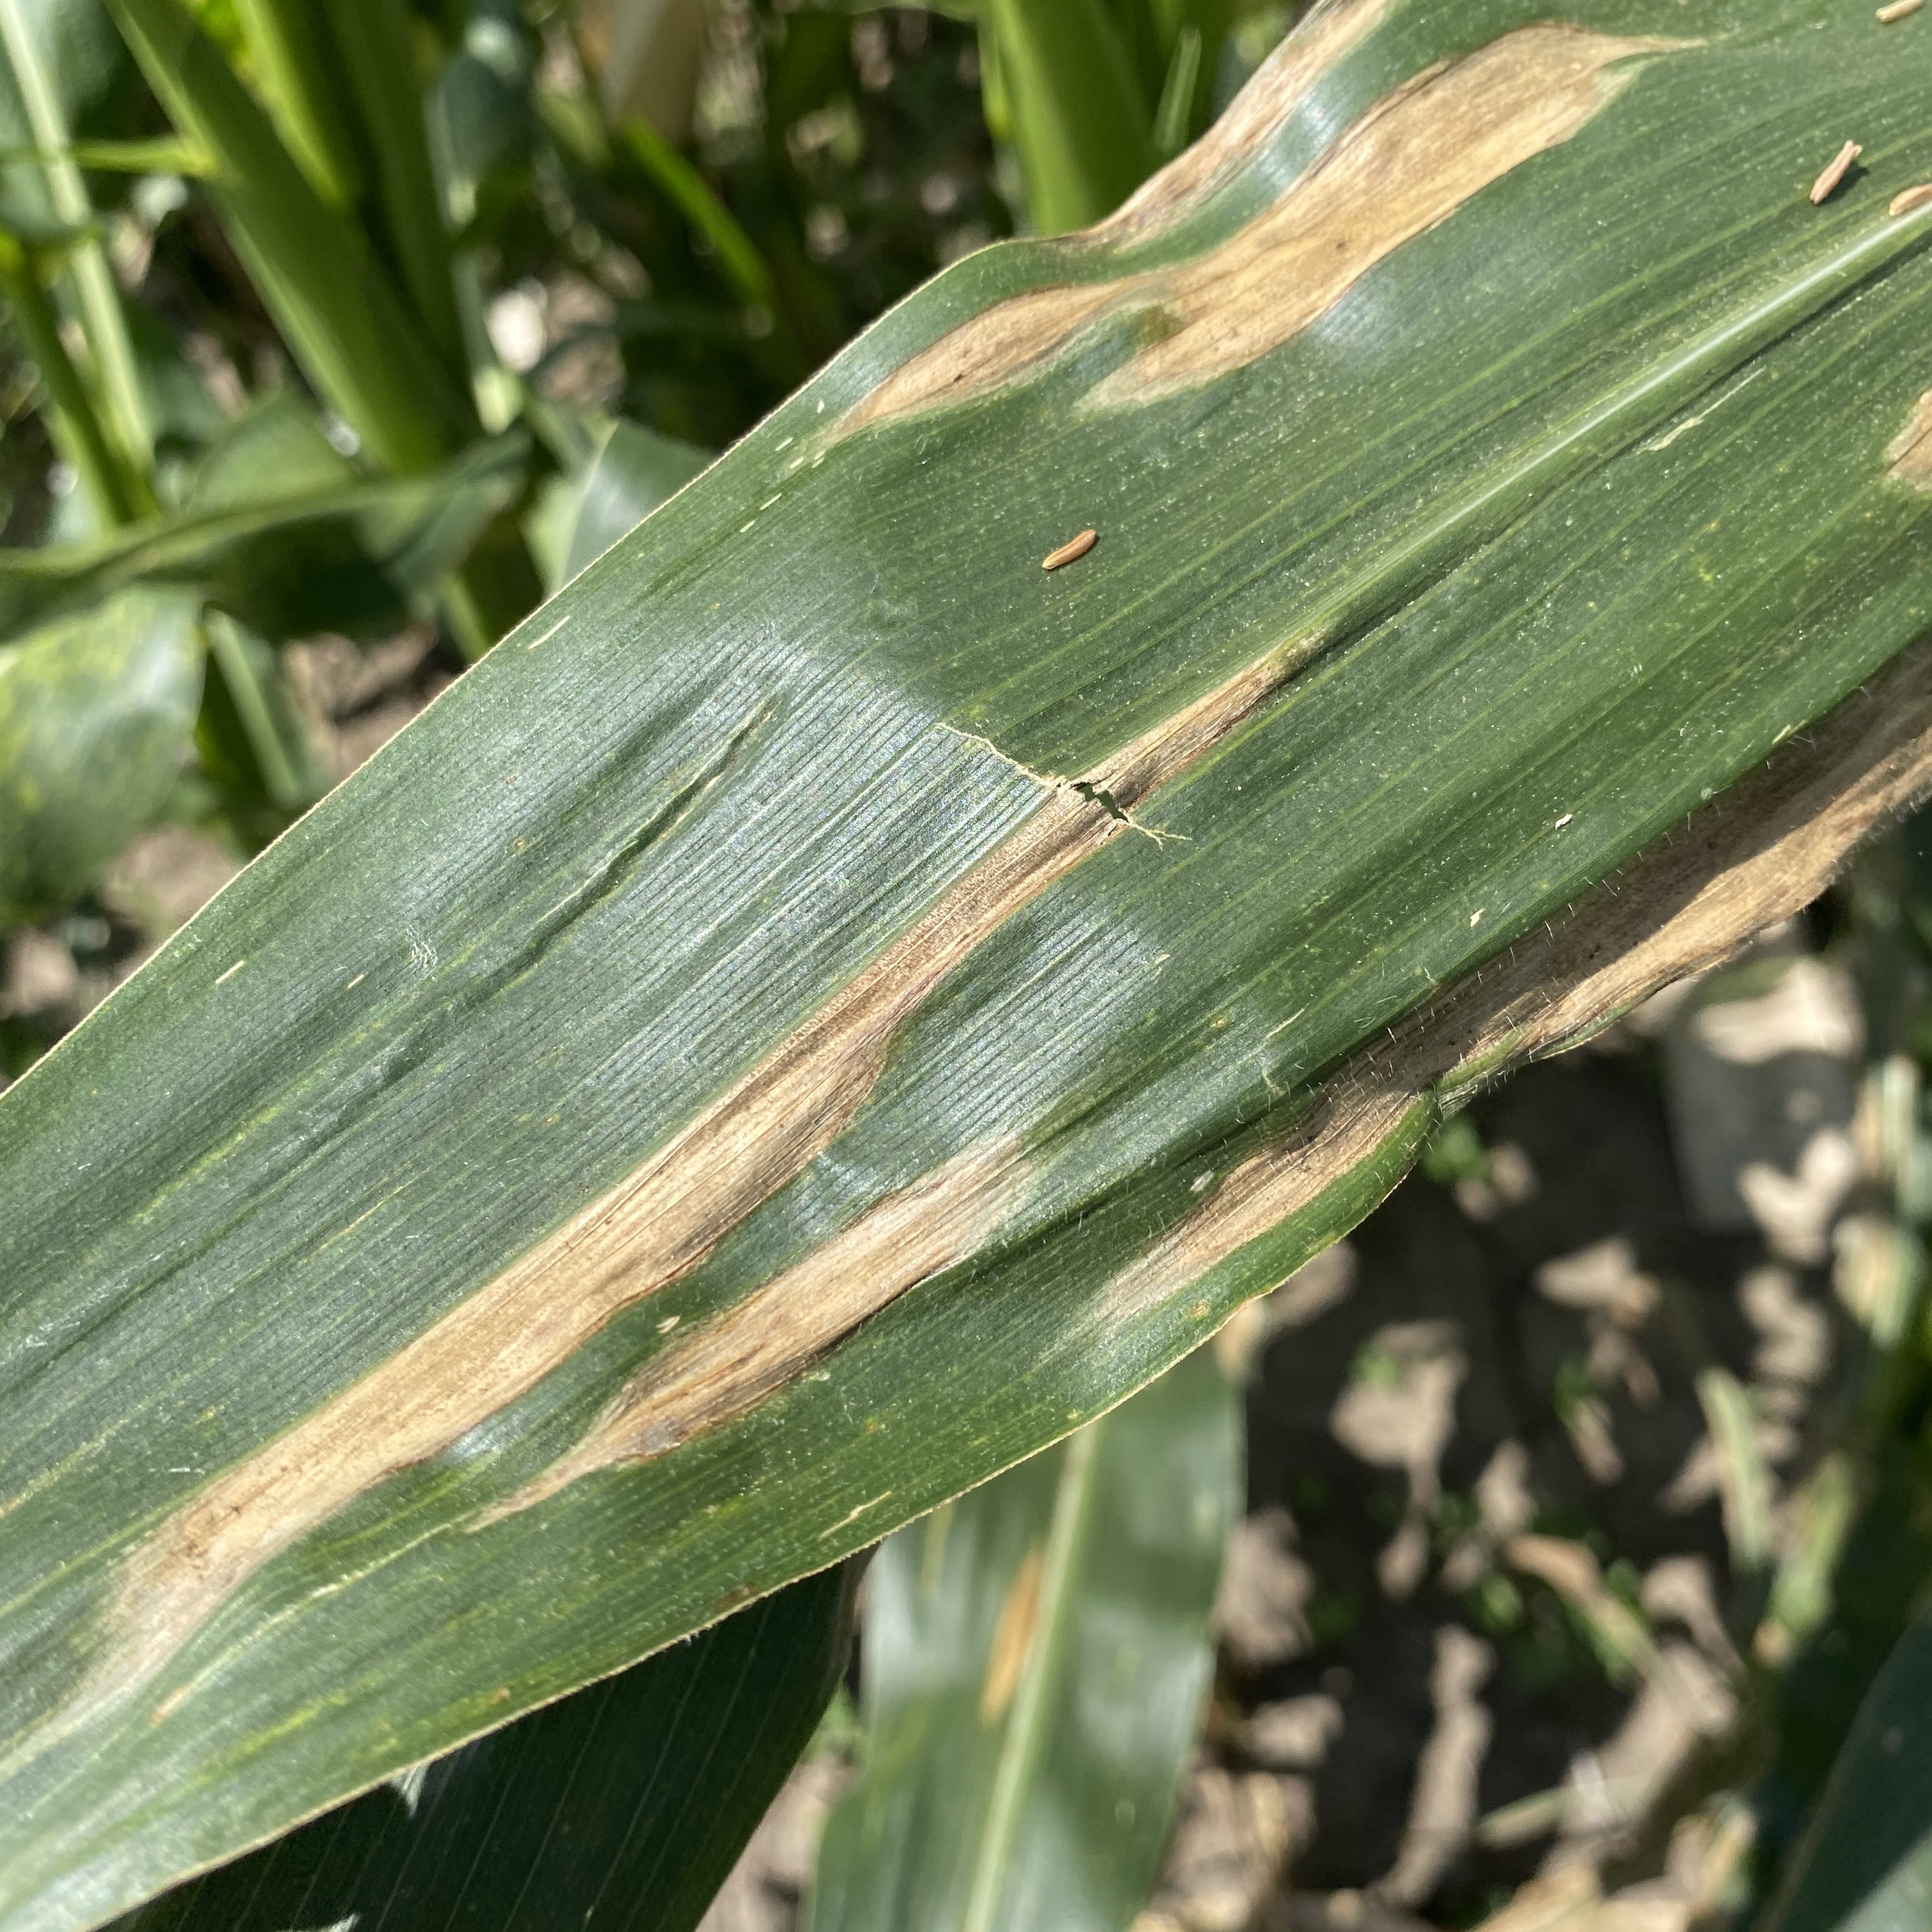
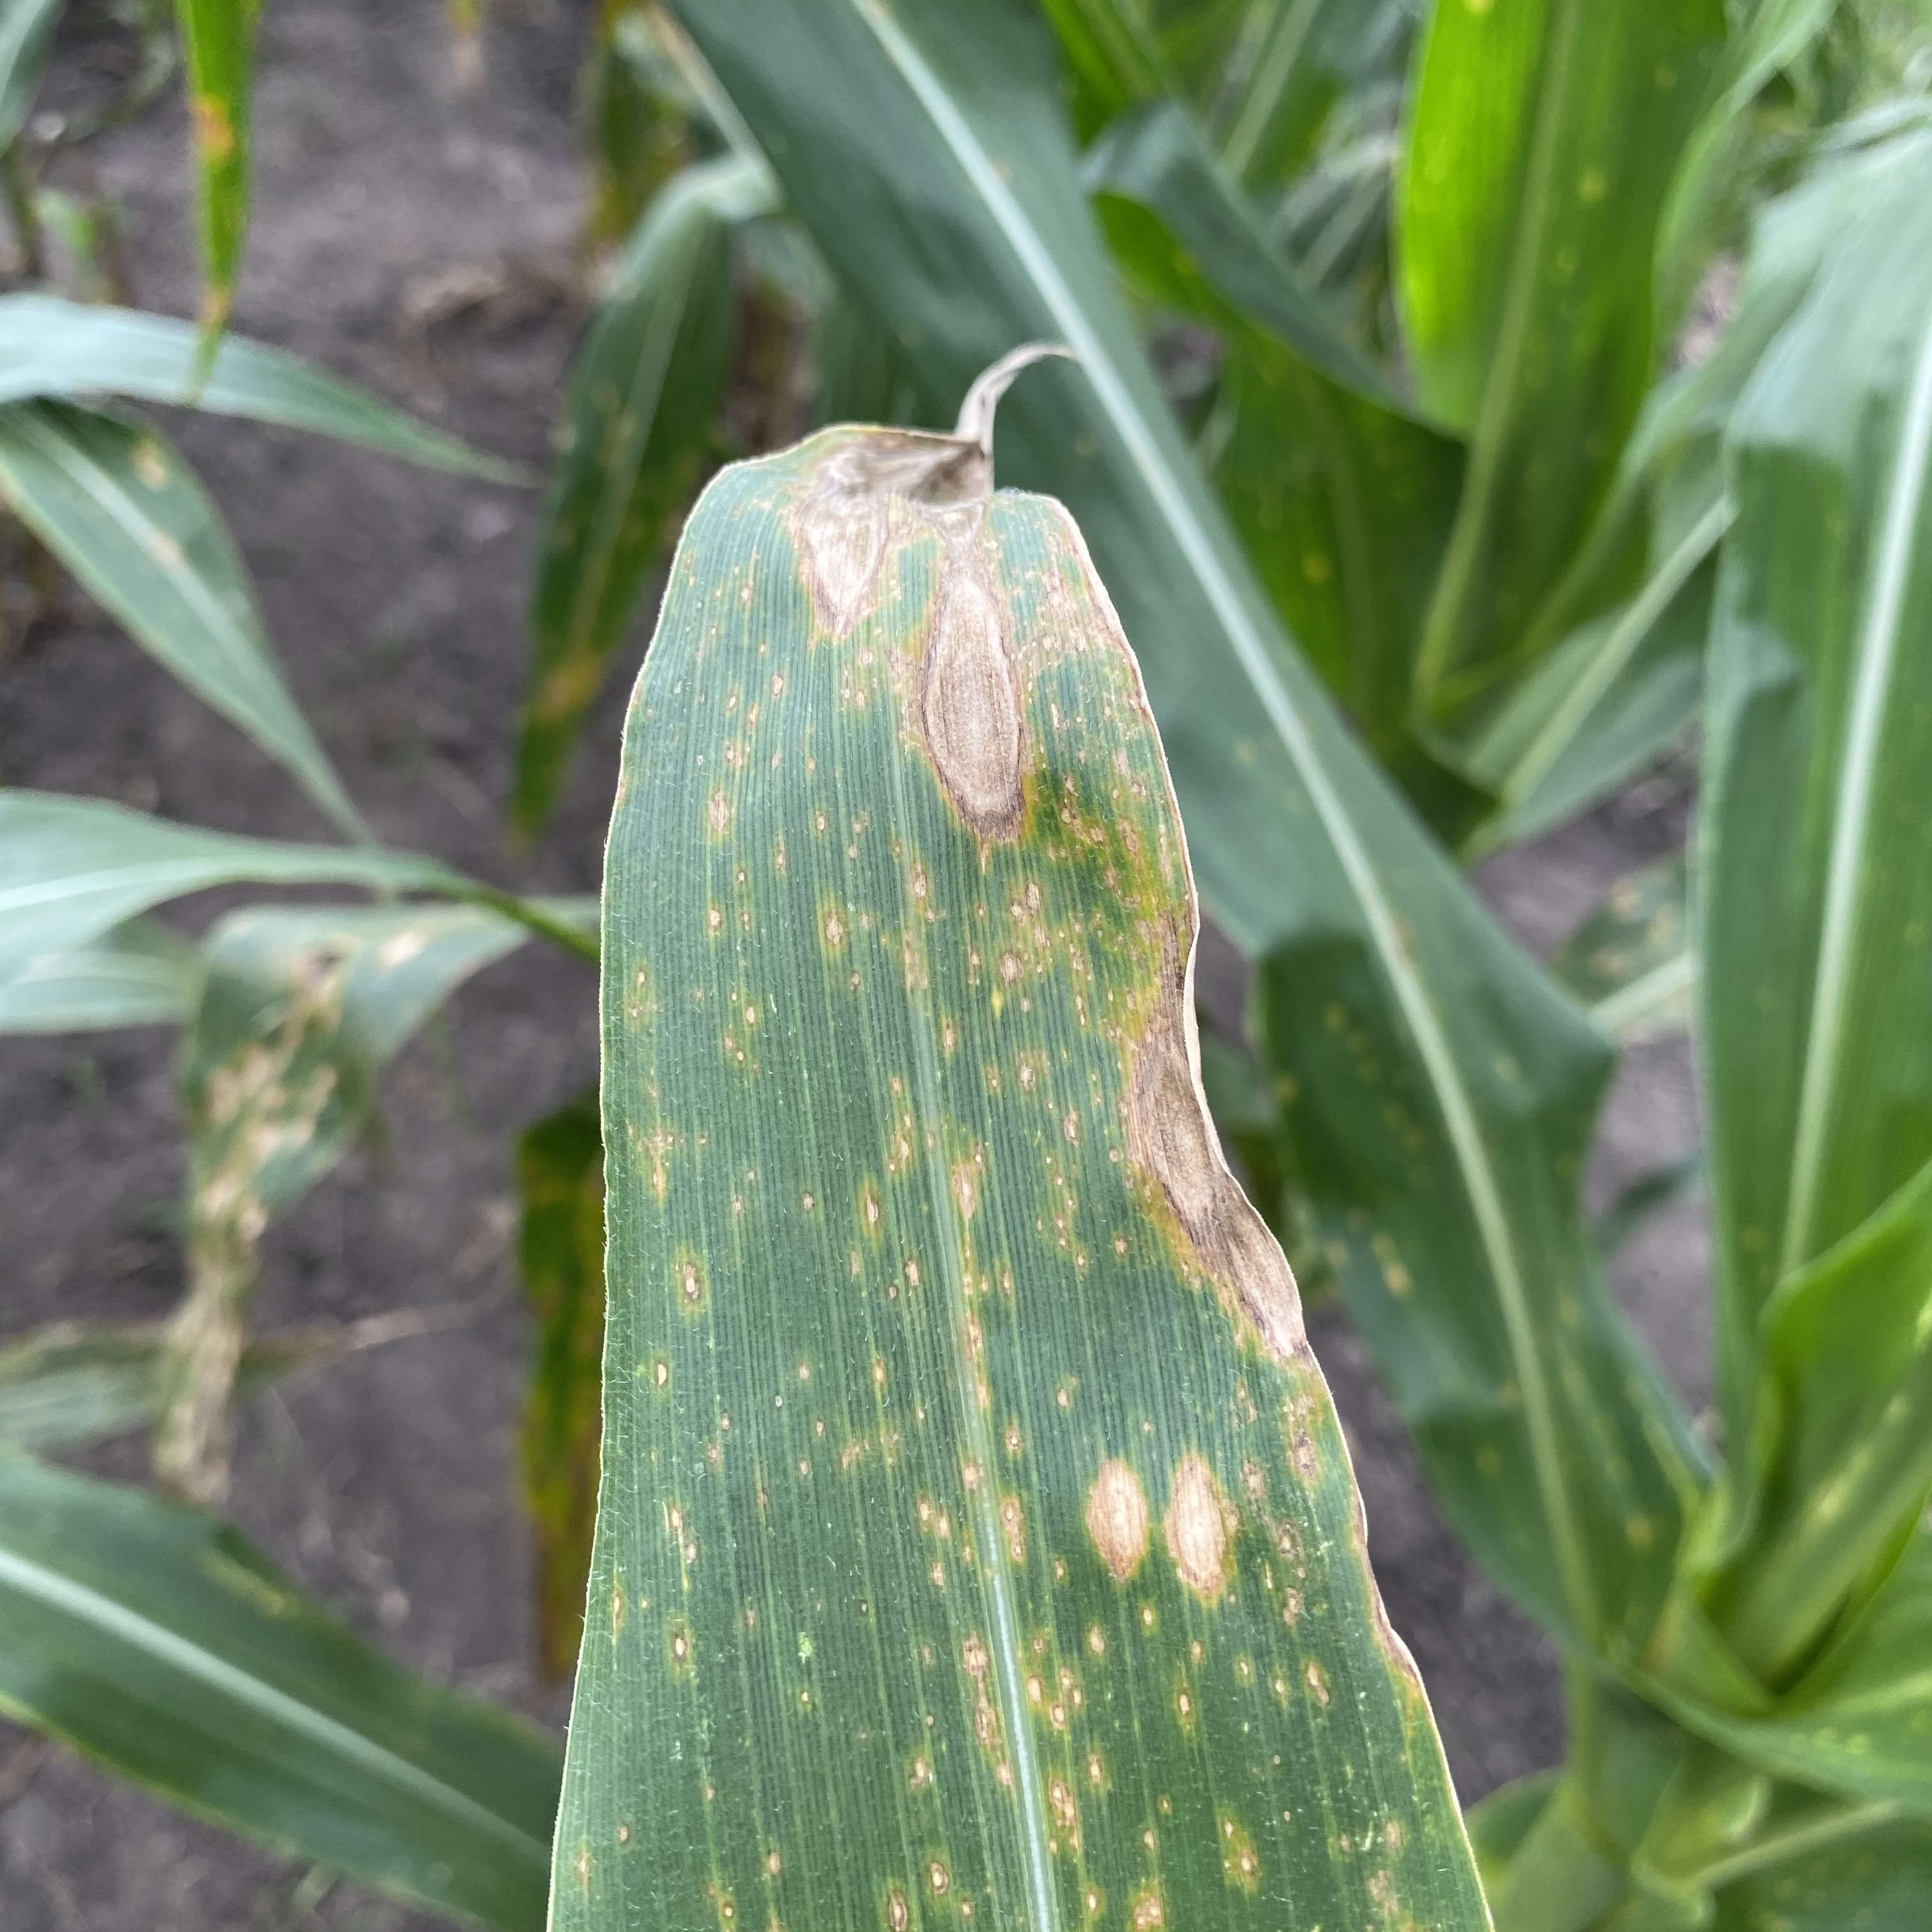
Deep Learning Applications
Model Identifies Input as Tar Spot
Image Classification
GLS
Trained Image Classification Model
NLB
NLS
Input Tar Spot Image

Slide 5
Deep Learning Applications
Object Detection
Trained Object Detection Model
NLB Lesions Identified
Input NLB Image
Notes:
1. A limitation of image classification is that it is unable to locate identified objects
2. Additionally, presence of multiple objects within images cannot be identified
3. Object detection however overcomes this limitation
4. In this study, the bounding box annotations that were created for the tar spot disease
5. Were used to train the YOLOv4 object detection model to locate and identify the presence of multiple tar spot lesions present on individual corn leaves.

Slide 6
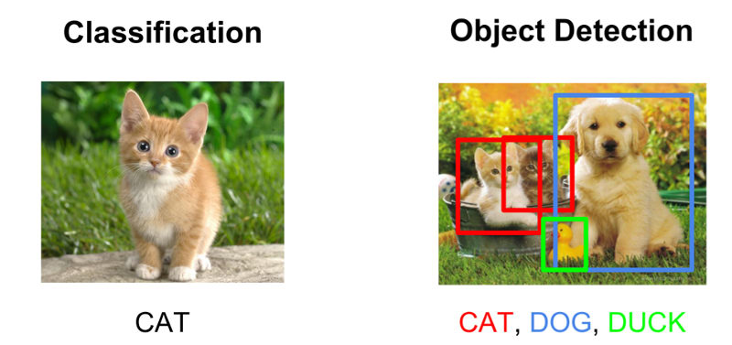
Deep Learning Applications
Image Classification vs. Object Detection
https://tinyurl.com/mrfkssee

Slide 7
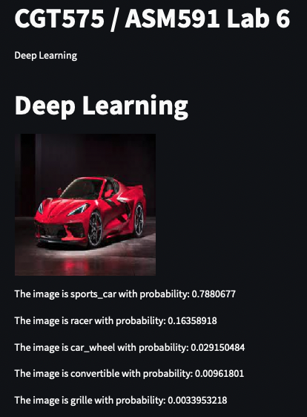
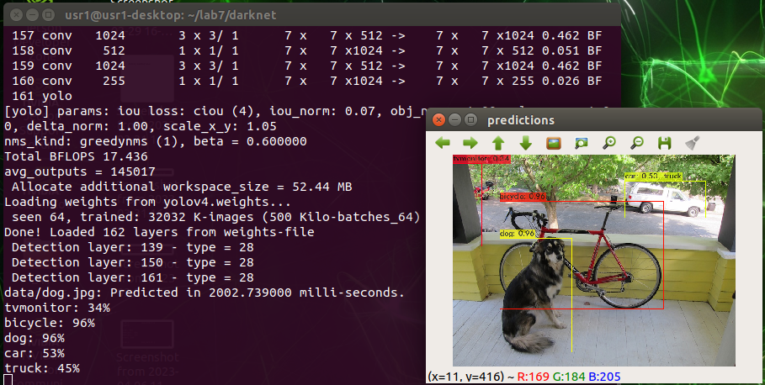
Deep Learning Applications
Image Classification vs. Object Detection

Slide 8
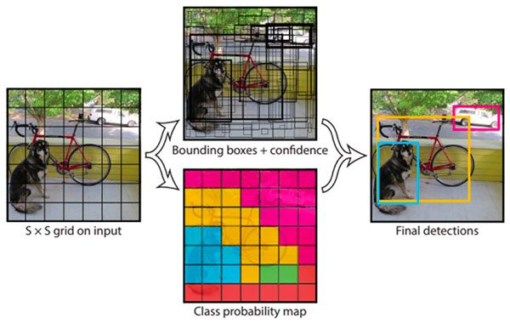

YOLO Object Detection Algorithm
Single Stage Object Detection
https://tinyurl.com/3usmmytd
https://tinyurl.com/bdfppuzd

Slide 9
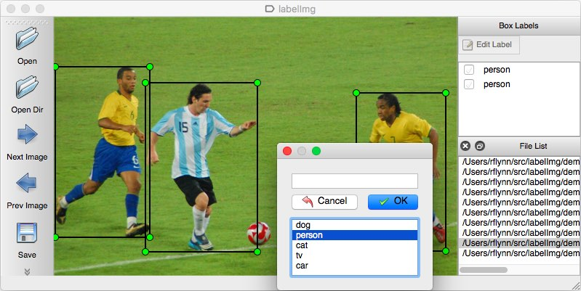
Prepare Dataset for Object Detection
Bounding Box Annotation
Create bounding boxes around objects
Assign each bounding box to a class
Train object detection models
https://tinyurl.com/2p8fnv68

Slide 10
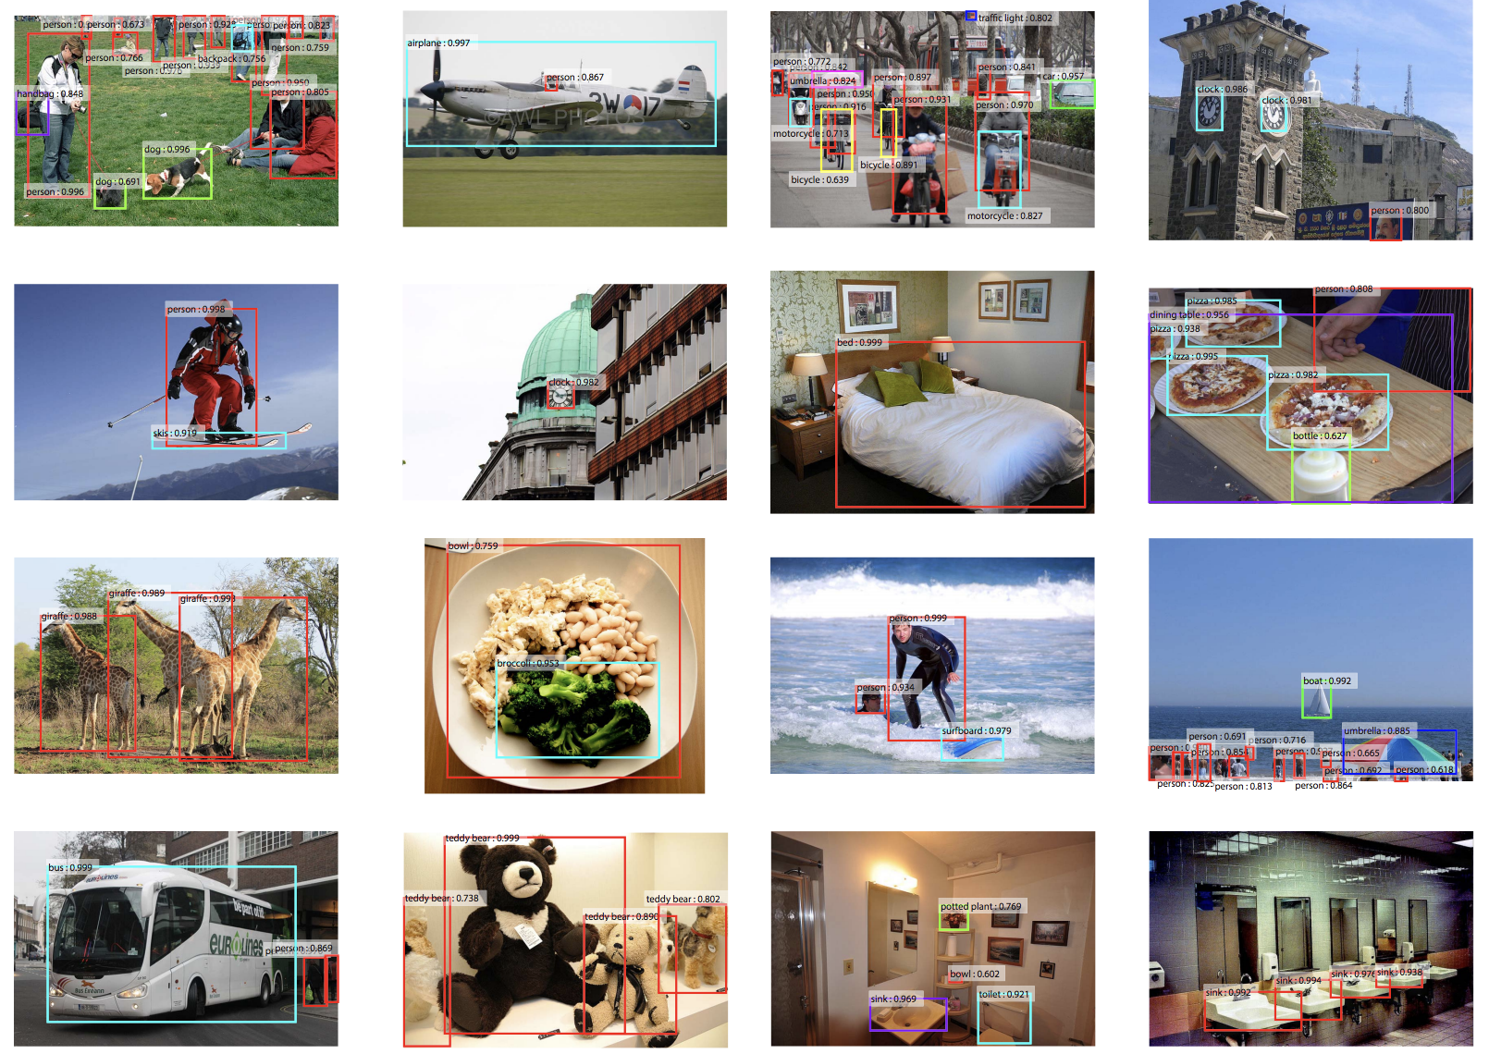
In this lab
Use Pre-trained Weights Trained on Benchmark COCO Dataset
Use pre-trained weights
Load the weights
Perform real-time object detection
https://tinyurl.com/2p8u2255

Slide 11
Overview
Lab7: Object Detection
Objective 1, 2
Objectives 3
Objectives 4
Objective 5
Setup
Perform Live Object Detection
Perform Object Detection on Images
Homework
Install the required libraries and dependencies
Load pre-trained model
Load pre-trained model
Obtain 5 images from Google
Clone the YOLO GitHub repository
Use the CSI camera to perform live object detection
Feed the image into the object detection model
Feed each image into the object detection model
Modify starting code
Modify the web app from lab 6 and add another page
Prepare the Makefile for object detection

